Slide 1
Stomach

Slide 2
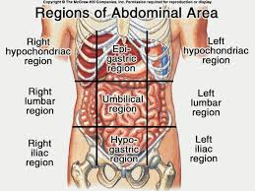
introduction
Widest part of alimentary tract
Lies btw.oesophagus and duodenum
Mean capacity- 30 ml (at birth), 1000ml (puberty), 1500ml(adult)
Situation- left hypochondric,epigastric and umbilical area.

Slide 3
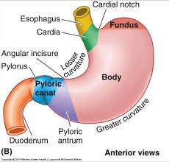
exterior

Slide 4
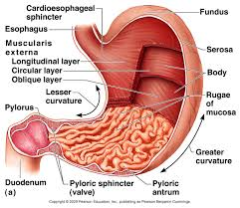
interior

Slide 5
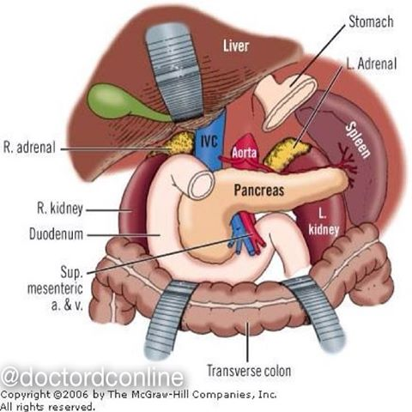
relations
Stomach bed
Left crus and lower fibre of diaphragm
Left inferior phrenic vessels
Left kidney
Left suprarenal gland
Ant.surface of pancreas
Left.colic flexure & transerse mesocolon
Spleen
Splenic artery

Slide 6
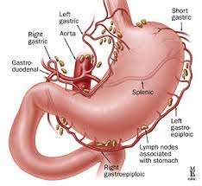
Blood supply

Slide 7
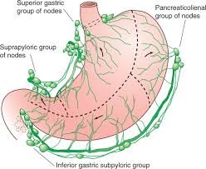
Lymphatics

Slide 8
Nerve supply
Sympathetic- coeliac plexus T5-T12 spinal segments .
Parasympathetic- vagus nerve .

Slide 9
Clinical anatomy
Gastritis
Congenital hyperpyloric stenosis- congenital thickening of pyloric sphincter.
Gastric ulcer
Gastric carcinoma

