Slide 1
OESOPHAGUS

Slide 2
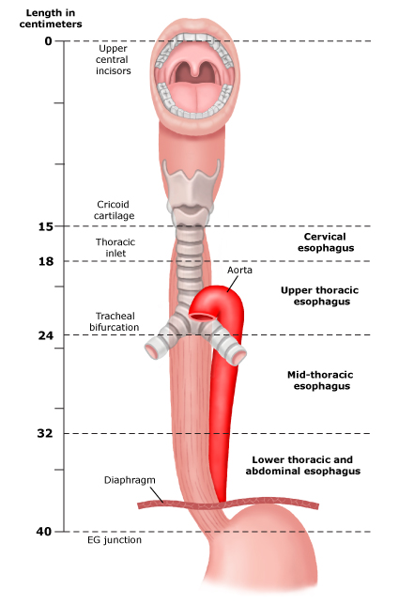
INTRODUCTION
Length -25 cm
Begins in neck at lower border of cricoid cartilage at level C6
Ends at gastric cardiac orifice at T11
It is the narrowest part of alimentary tract except appendix.

Slide 3
It has 4 constrictions
1.At beginning – 15 cm from incisors
2.Where crossed by arch of aorta- 22.5cm
3.Crossed by lt.bronchus-27.5 cm
4.Pass through diaphragm- 40cm

Slide 4
Cervical oesophagus
Anteriorly - trachea
Sides- recurrent laryngeal nerve
Posteriorly- vertebral column, longus coli, prevertebral fascia.
Laterally- common carotid arteries, post. Part of thyroid
Left – thoracic duct

Slide 5
Thoracic oesophagus
Situated left in sup. Mediastinum btw. Trachea & V.C.
Passes behind & rt.to aortic arch to descend in post. Mediastinum along rt. Side of thoracic aorta.
As inclines left it crosses ant. To aorta & enter abdomen at T10.

Slide 6
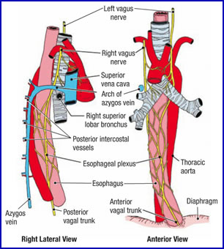
Relations
Ant.- trachea, rt.pulmonary artery,lt.bronchus, pericardium,diaphragm
Post.- V.C., longus coli, rt. Post. Intercostal arteries, thoracic duct, azygos vein.
Left- in sup. Media- aortic arch, lt. subclavian artery, thoracic duct,lt.pleura,recurrent laryngeal nerve
In post.media- descending thoracic aorta, lt.pleura
Right- rt.pleura,azygos vein, rt.main bronchus

Slide 7
Abdominal oesophagus
1-2.5 cm long
Enters abd. By piercing diaphragm atT10
It runs obliquely to left & posteriorly
Ends at gastroesophageal junction at T11

Slide 8
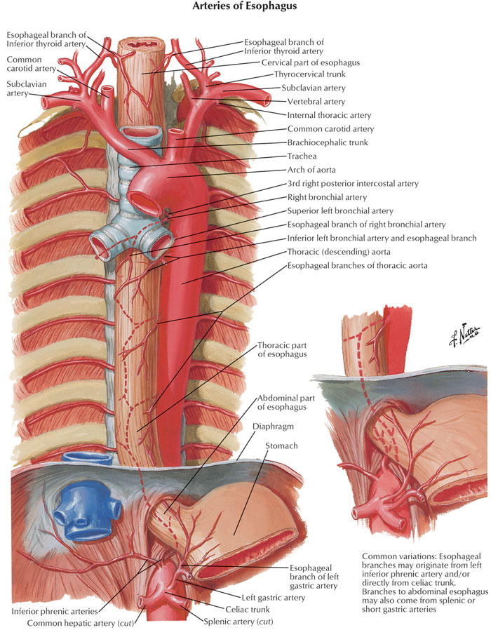
Blood supply
Cervical- oesophageal branch of inf. Thyroid artery
Thoracic- ascending branch of lt.phrenic A
Abdominal- lt.gastric artery

Slide 9
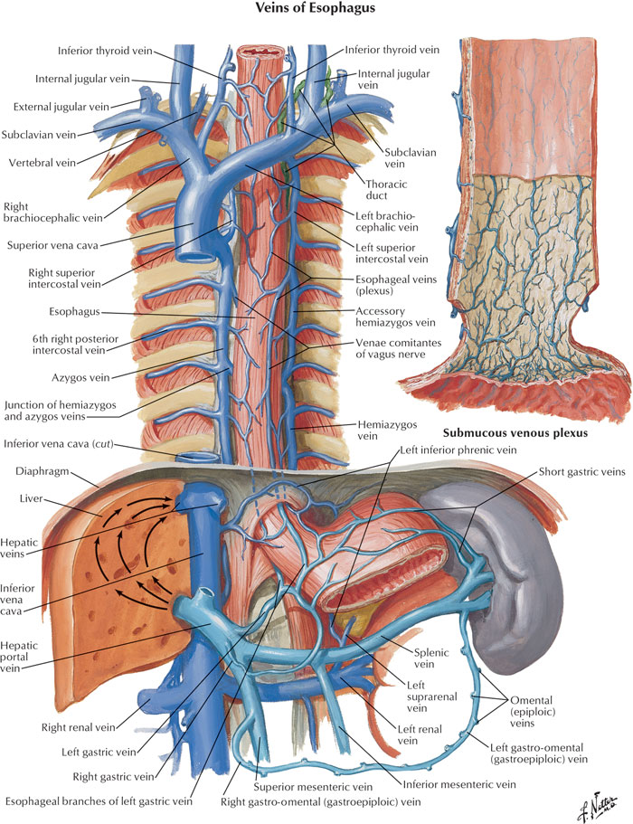
Venous & lymphatic drainage
Left gastric vein
Upper short gastric veins
Lymphatics- lt.gastric, rt.paracardial to paraaortic nodes

Slide 10
Nerve supply
Recurrent laryngeal nerve
Vagus nerve
Parasympathetic- peri oesophageal thoracic plexus (T5-T12)
Sympathetic- greater & lesse splanchnic nerves, coeliac plexus

Slide 11
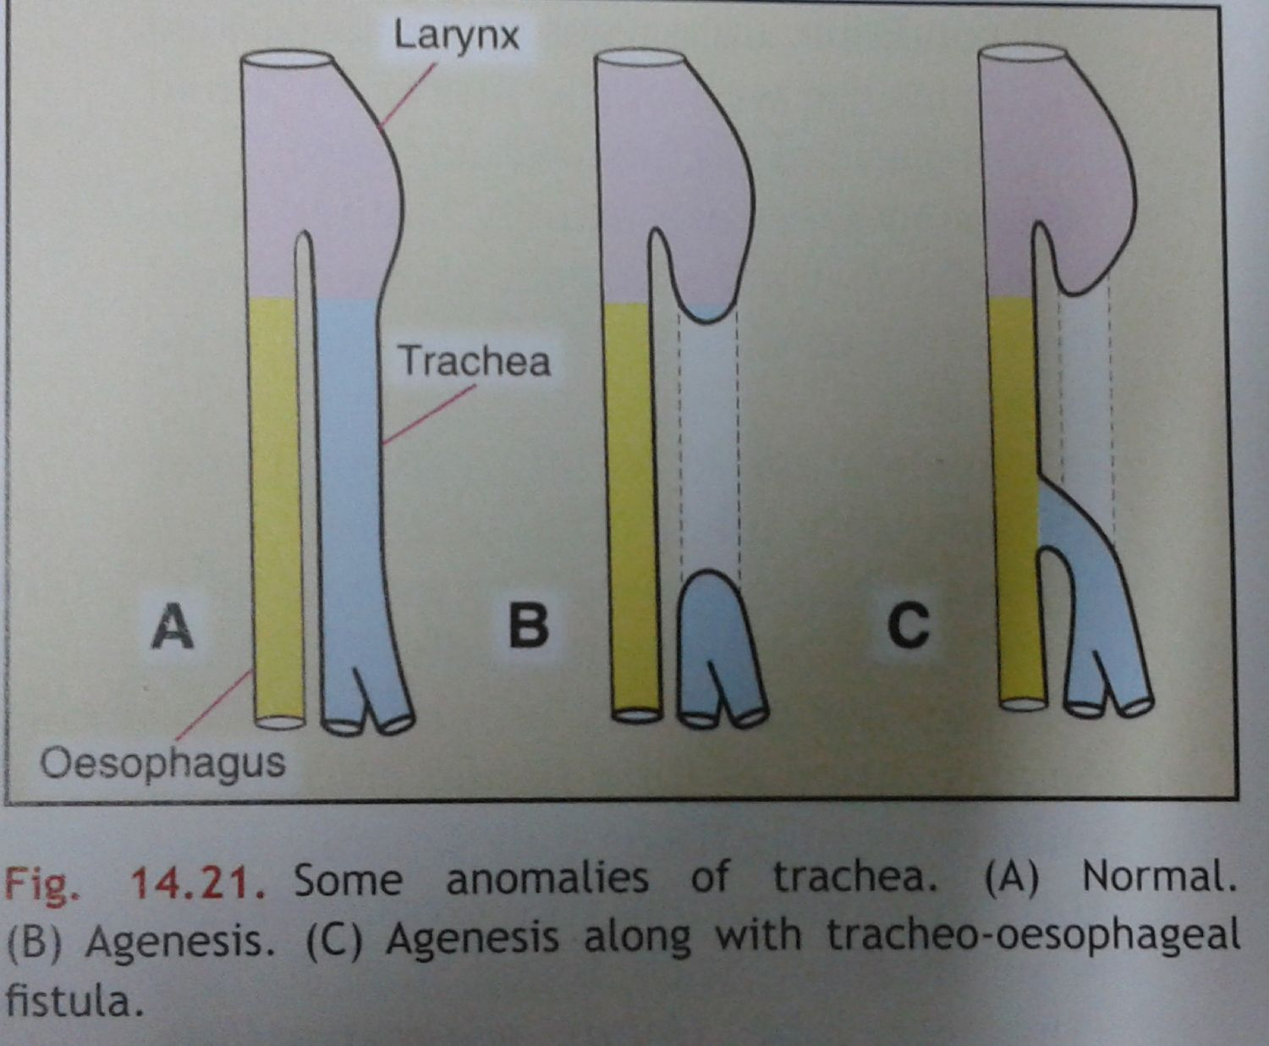
Clinical anatomy
Achlasia cardia- due to failure of sphincter to relax leads to dysphagia with constricted lumen having rat tail appearance in barium radiograph.
Oesophagitis-regurgitation results in inflammation of oesophagus.
Hiatus hernia
Oesophageal varices
Tracheooesophageal fistula

