Slide 1
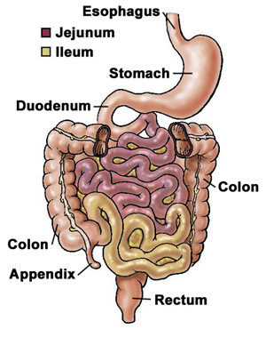
JEJUNUM & ILIUM

Slide 2
Features | Jejunum | Ilium
Position | Left infracolic compartment upto umbilical region | Pelvic region ends in rt.iliac fossa by opening into ilioceacal valve.
Median external diameter | 4cm | 3.5cm
Median internal diameter | 2.5cm | 2cm
Walls | Thicker | Thinner
Plica circularis | More pronounced | Less (flat in terminal part)
Lymphoid aggregates | Less | More

Slide 3
Vascular Supply
Arterial –
Jejunal & ilial branches of Sup.mesenteric artery.
Venous drainage- jejunal, ilial, iliocolic, rt.colic, middle colic, rt. Gastroepiploic, pancreaticoduodenal tributeries into sup. Mesentric vein.
Lymphatic drainage- mesenteric lymph nodes .
Innervation:-
Sympathetic- mid thoracic spinal segment via splanchnic nerve and sup. mesentric ganglions
Parasympathetic:-ant. and right vagus nerve .

Slide 4
Histology of GI Tract
Entire GI tract is formed of 4 layers
1.Mucosa-
a) lining epithilium
b) lamina propria- made up of connective tissue containing glands, blood and lymph vessels
c)Muscularis mucosa- made up of 2 layers inner circular and outer longitudinal.
2. Submucosa- dense irregular connective tissue containing blood vessels, lymphatic vessels, nerve plexus and occasional glands.
3. Muscularis externa- inner circular and outer longitudinal layer containing myenteric nerve plexus.
4.Serosa – simple squamous epithilium(peritoneum)

Slide 5
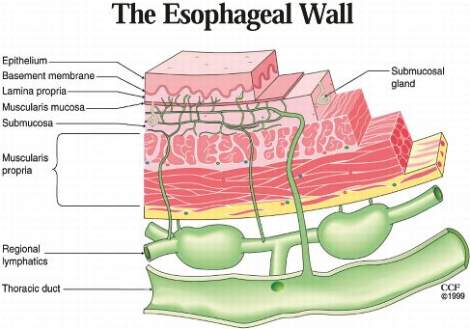
Histology of oesophagus
1.Mucosa- non-keratinized stratified squamous epithilium.
Lamina propria – oesophageal cardiac glands (lower part)
Muscularis mucosa- single longitudinal layer of smooth muscle.
2. submucosa- oesophageal glands
3.Muscularis externa-
upper1/3 –skeletal muscle
middle 1/3- skeletal & smooth
Lower1/3-smooth
Arranged in 2 layers inner circular& outer longitudinal
4.Adventitia – loose connective tissue without peritoneum

Slide 6
Histology of stomach
Mucosa- simple columnar epithilium having surface mucous cells, invaginations are called gastric pits.
Lamina propria- long tubular fundic glands which contain
1.Mucous neck cells- low columnar secrets soluble mucus.
2.Chief/zymogenic/ peptic cells- low cuboidal secrets pepsinogen,lipase, amylase.
3.Parietal/oxyntic cells- large pyramidal secrets hcl and gastric intrinsic factor
4. Enteroendocrine cells- unicellular secrets gastrin, somatostatin and histamine.
Submucosa – irregular dense connective tissue containing b.v. ,l.v.& n.p.
Muscularis externa – inner oblique, outer longitudinal and middle circular.
Serosa- loose connective tissue covered with peritoneum.

Slide 7
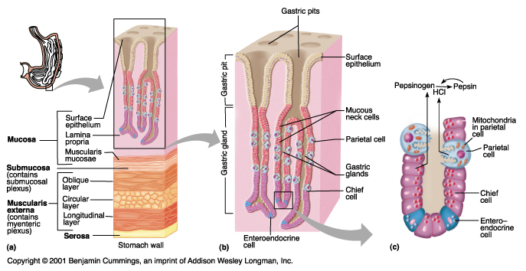

Slide 8
Histology of small intestine
Special features-
Plica circularis/ valves of kerckring- mucosa & submucosa is thrown into permanent folds which are numerous in distal duodenum and jejunum and less in ilium.
Villi- a finger like projection lined by surface epithilium with lamina propria projecting into it. Villus contain core of loose connective tissue, fenestrated blood capillaries and a central blind ended lymphatic vessel called lacteal.
these are large and numerous in duodenum and smaller in ilium.
Intestinal glands/ crypts of lieberkuhn- invaginations of epithilium into lamina propria which open on luminal surface of intestine at base of intervillous space. It contains :

Slide 9
Conti…..
enterocyte – columnar absortive cells their surface bear up to 3000 microvilli. Microvilli posses a specialized glycoprotein called glycocalyx.
Goblet cells- produce mucus which protect against microorganisms and toxins.
Paneth cells- found in deeper parts of crypts(duodenum) secretion protects against bacterial flora.
Stem cells- source of most of cell type of intestinal epithilium.
Enteroendocrine cells- secretes local harmones
Cholecytokinin (inc.activity of g.b. & pancreas)
Gastric inhibitory polypeptide (inhibit gastric secretion and motility)
Secretin (stimulate release of insulin in pancreas)
Motilin (stimulate gastric and intestinal motility).

Slide 10
Conti….
Microfold (M) cells-epithilial cells overlying lymphoid aggregates in intestinal wall. They taken up antigen from int.lumen and come in contact with cells of immune system and produce antibodies (IgA).
Peyer’s patches- aggregate lymphoid follicles present in lamina propria of small intestine especially ilium which protect gut against invasion of microorganisms.

Slide 11
Duodenum
Mucosa- simple columnar with microvilli & few goblet cells r seen
lamina propria contains crypts of lieberkuhn which contain columnar, goblet, paneth and enteroendocrine cells.
Muscularis mucosa is made up of inner circular and outer longitudinal layer. Plica circularis r seen.
Submucosa contain brunner‘s gland which secrets alkaline mucus to neutralize acid chyme.
Muscularis externa is made up of inner circular and outer longitudinal layer containing myenteric plexus.
Serosa contain only 1st part of duodenum.

Slide 13
Jejunum & ilium
Jejunum is same as duodenum with absence of brunner’s and payer patches.
Mucosa is lined by simple columnar epithilium with microvilli.
Prominent intestinal villi and plica circularis.
Ilium is same as jejunum
mucosa is lined by simple columnar epithilium with microvilli.
Villi are short and few.
Lamina propria contains peyer’s patches. M cells r found overlying lymphoid follicles.
Muscularis mucosa is thin than jejunum.

Slide 14
Thank you

